Slide 1
Arrays (Chapter 7)
Arrays in classes and methods
Programming with arrays and classes
Sorting and searching arrays
Multidimensional arrays

Slide 2

Creating and Accessing Arrays
An array is a special kind of object
Think of as collection of variables of same type
Creating an array with 7 variables of type double
To access an element use
    The name of the array
    An index number enclosed in braces
Array indices begin at zero

Slide 3
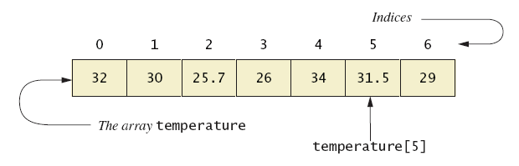
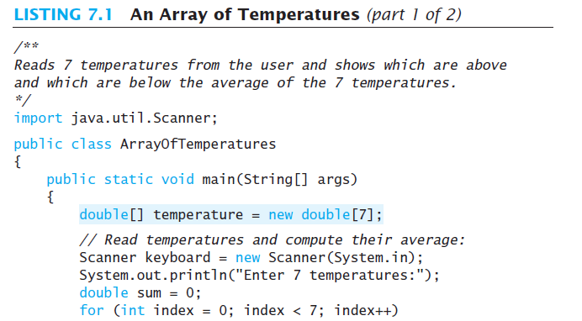
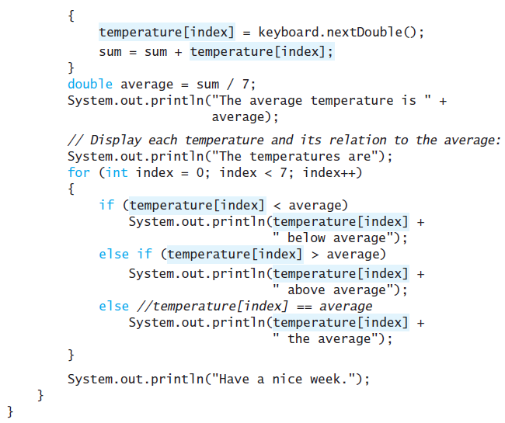
Creating and Accessing Arrays
A common way to visualize an array

Slide 4

Array Details
Syntax for declaring an array with new
The number of elements in an array is its length
The type of the array elements is the array's base type

Slide 5
Square Brackets with Arrays
With a data type when declaring an array
int [ ] pressure;
To enclose an integer expression to declare the length of the array
pressure = new int [100];
To name an indexed value of the array
pressure[3] = keyboard.nextInt();

Slide 6
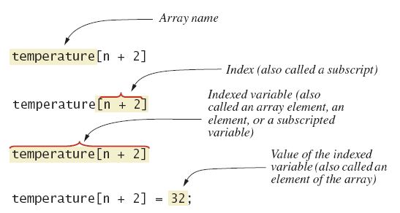
Array Details
Array terminology

Slide 7
The Instance Variable length
As an object an array has only one public instance variable
  Variable length
  Contains number of elements in the array
  It is final, value cannot be changed
    e.g. temperature.length

Slide 8
More About Array Indices
Index of first array element is 0
Last valid Index is arrayName.length – 1
Array indices must be within bounds to be valid
    When program tries to access outside bounds, run time error occurs
OK to "waste" element 0
    Program easier to manage and understand
    Yet, get used to using index 0

Slide 9
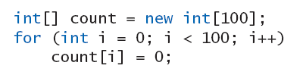
Initializing Arrays
Possible to initialize at declaration time
Also may use normal assignment statements
  One at a time
  In a loop

Slide 10
Arrays in Classes and Methods: Outline
Case Study: Sales Report
Indexed Variables as Method Arguments
Entire Arrays as Arguments to a Method
Arguments for the Method main
Array Assignment and Equality
Methods that Return Arrays

Slide 11
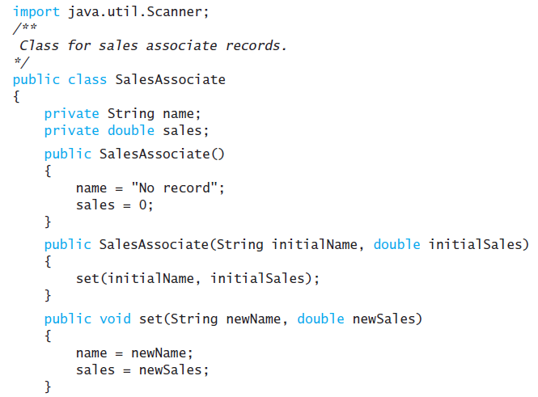
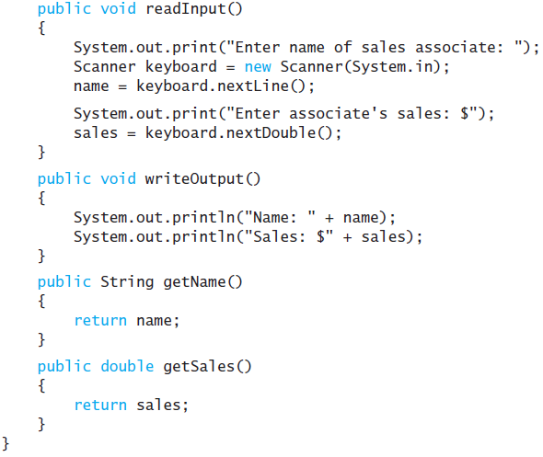
Case Study: Sales Report

Slide 12
Case Study: Sales Report
Main subtasks for our program
Get ready
Obtain the data
Compute some statistics (update instance variables)
Display the results

Slide 13
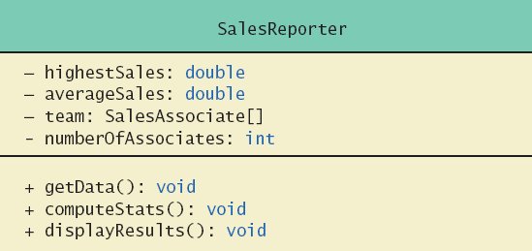
Case Study: Sales Report
class SalesReporter

Slide 14
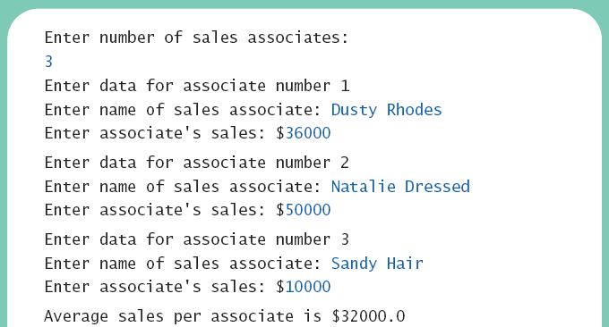
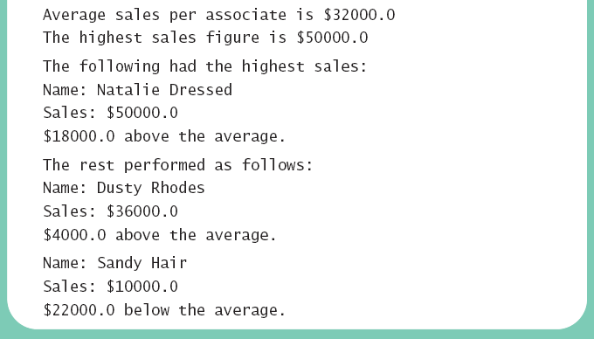
Case Study: Sales Report
Sample
screen output

Slide 15
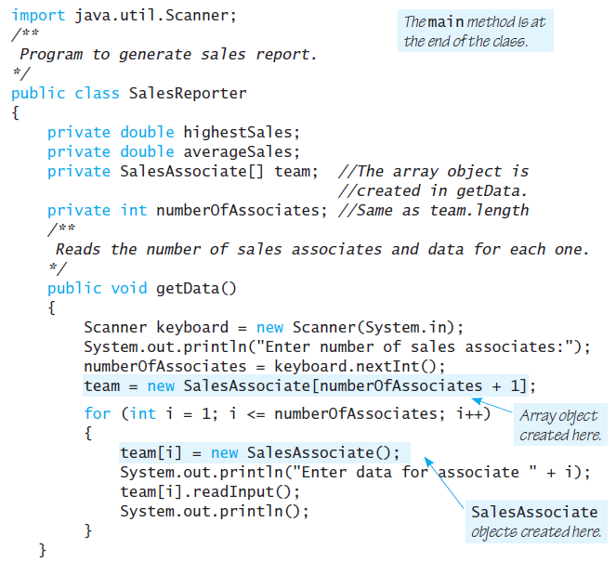
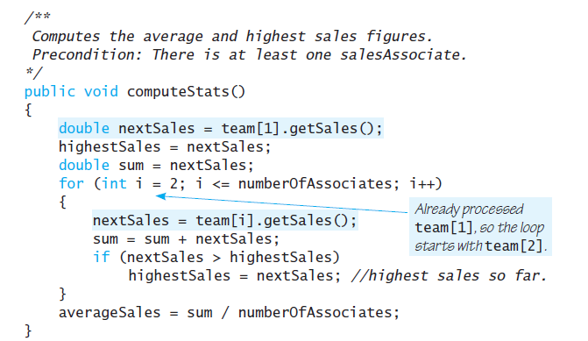

Slide 16
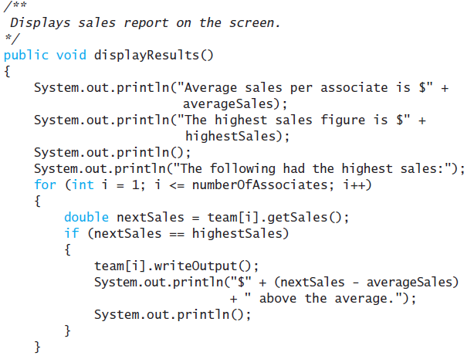
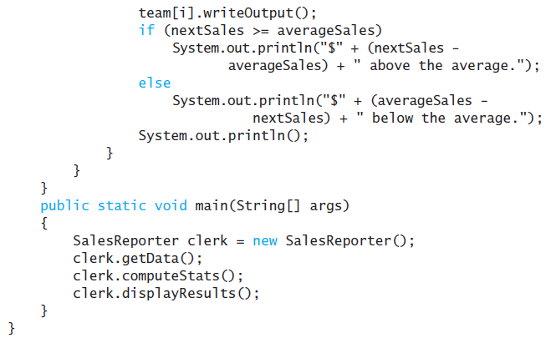
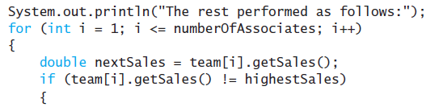

Slide 17
Indexed Variables as Method Arguments
Indexed variable of an array
  Example … a[i]
  Can be used anywhere variable of array base type can be used

Slide 18
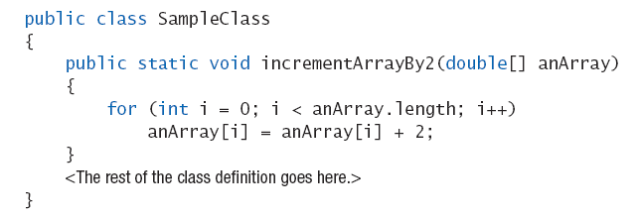
Entire Arrays as Arguments
Declaration of array parameter similar to how an array is declared
Example:

Slide 19
Entire Arrays as Arguments
Note – array parameter in a method heading does not specify the length
  An array of any length can be passed to the method
  Inside the method, elements of the array can be changed
When you pass the entire array, do not use square brackets in the actual parameter

Slide 20
Arguments for Method main
Recall heading of method main
public static void main (String[] args)
This declares an array
  Formal parameter named args
  Its base type is String
Thus possible to pass to the run of a program multiple strings
  These can then be used by the program

Slide 21
Array Assignment and Equality
Arrays are objects
  Assignment and equality operators behave (misbehave) as specified in previous chapter
Variable for the array object contains memory address of the object
  Assignment operator = copies this address
  Equality operator == tests whether two arrays are stored in same place in memory

Slide 22
Array Assignment and Equality
Note results of ==
Note definition and use of method equals
  Receives two array parameters
  Checks length and each individual pair of array elements
Remember array types are reference types

Slide 23
Gotcha – Don’t Exceed Array Bounds
The code below fails if the user enters a number like 4. Use input validation.
Scanner kbd = new Scanner(System.in);
int[] count = {0,0,0,0};
System.out.println("Enter ten numbers between 0 and 3.");
for (int i = 0; i < 10; i++)
{
int num = kbd.nextInt();
count[num]++;
}
for (int i = 0; i < count.length; i++)
System.out.println("You entered " + count[i] + " " + i + "'s");

Slide 24
Gotcha – Creating an Array of Objects
When you create an array of objects Java does not create instances of any of the objects! For example, consider the code:
We can’t access team[0] yet; it is null. First we must create references to an object:
we can now access team[0].getName() or team[1].getSalary()
SalesAssociate[] team = new SalesAssociate[10];
team[0] = new SalesAssociate("Jane Doe", 5000);
team[1] = new SalesAssociate("John Doe", 5000);

Slide 25
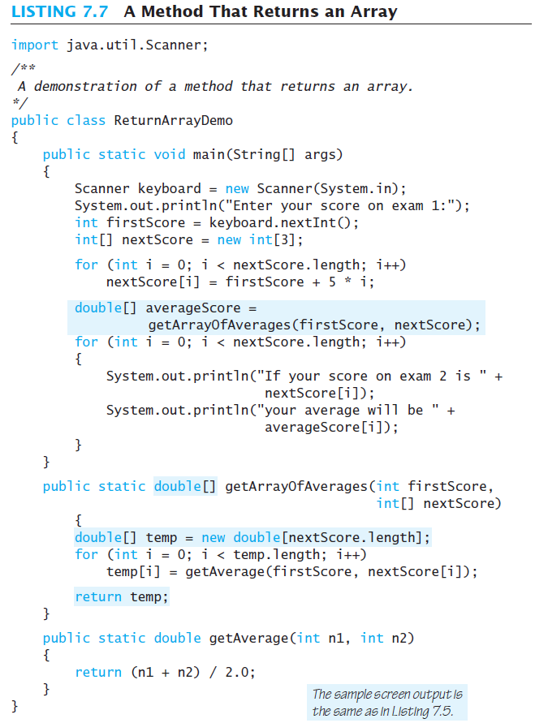

Slide 26
Methods that Return Arrays
A Java method may return an array
Note definition of return type as an array
To return the array value
  Declare a local array
  Use that identifier in the return statement

Slide 27
Programming with Arrays and Classes: Outline
Programming Example: A Specialized List Class
Partially Filled Arrays

Slide 28
Programming Example
A specialized List class
  Objects can be used for keeping lists of items
Methods include
  Capability to add items to the list
  Also delete entire list, start with blank list
  But no method to modify or delete list item
Maximum number of items can be specified

Slide 29
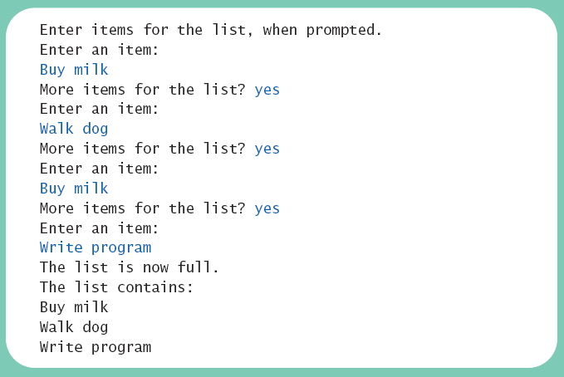
Programming Example
Sample
screen output

Slide 30
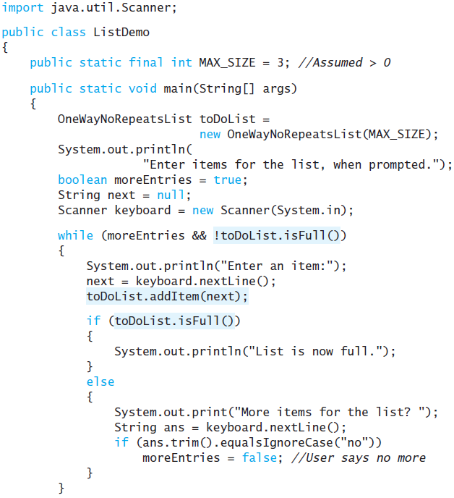
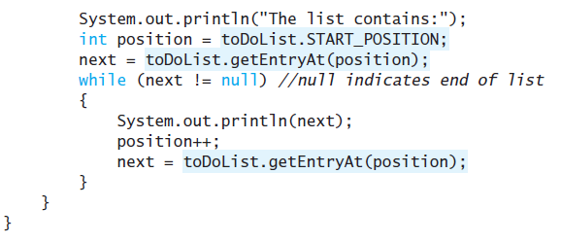
Programming Example

Slide 31
Programming Example
array wrapped in a class to represent a list
class OneWayNoRepeatsList
Notable code elements
  Declaration of private array
  Method to find n^{th} list item
  Method to check if item is on the list or not

Slide 32
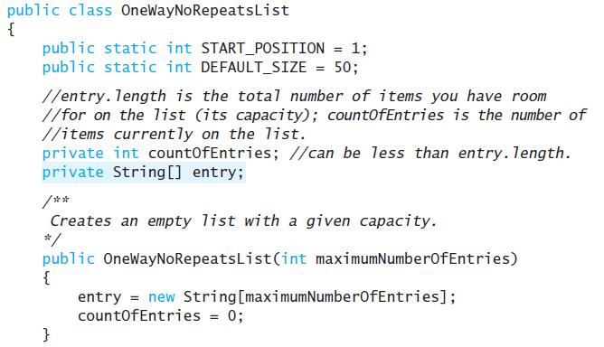
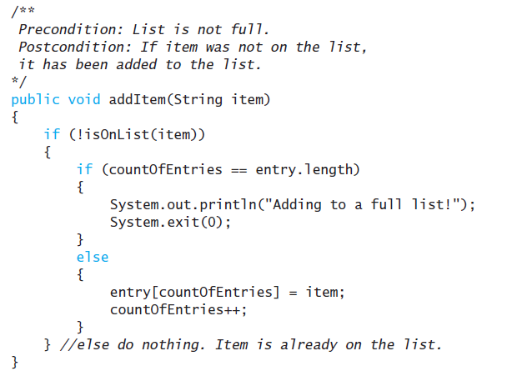
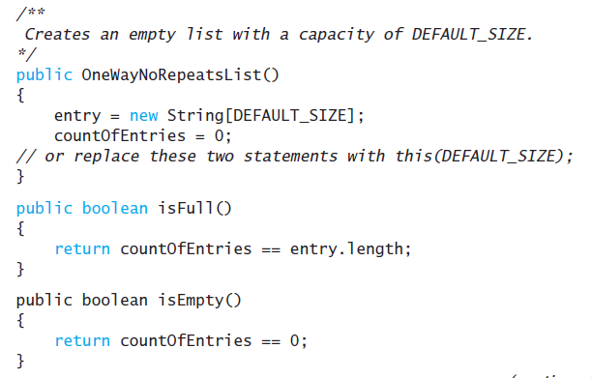
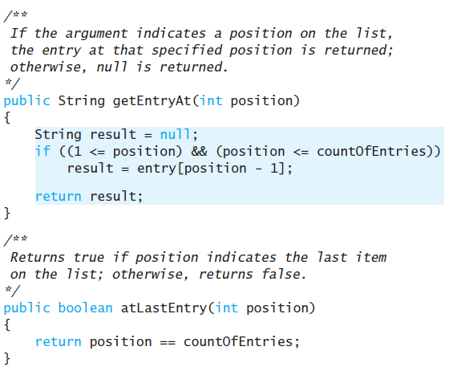

Slide 33
Partially Filled Arrays
Array size specified at definition
Not all elements of the array might receive values
  This is termed a partially filled array
Programmer must keep track of how much of array is used

Slide 34
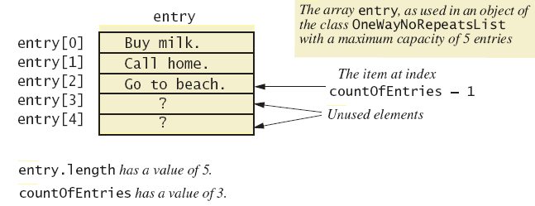
Partially Filled Arrays
A partially filled array

